Slide 1

.NET Developer Sr
Frontend + Backend
Evaluation Task

Slide 2
Goal
Create HTML code (aspx) for a Registration form
Feel free to improvise, it’s not a HTML position, so just do your best
Form validation
Using .NET and/or JavaScript/CSS (Jquery or Native javascript)
Model and create database: Tables and SPs (SQL Server)
Fields/Columns needs to be created based on the rules and form’s fields
Create a Web C# Application (website) integrated with the HTML (aspx)
Using .NET Framework 4.0

Slide 3
Business Rules – Step 1
In order to the user register on the website he will have to provide a valid document number
Only users that types a valid document number can go to step 2
We need to store a list of valid documents numbers in a database (table). The application needs to check if the number typed by the user exists in this table
In case the document number does not exists in the database, a friendly message will be displayed to the user
In case of a valid document number the step 2 needs to be displyed to the user
Has no restriction of how many times the same document number can be used

Slide 4
Business Rules – Step 2
On step 2, we need to show the document number (valid) typed by the user on step 1
This number cannot be edit, its read only
All fields marked with * are required and cannot be empty
In case of any required fields are not filled up, needs to show a friendly error (css - red border) as showed on the PSD File
The email field is UNIQUE. The registration cannot accept an email that already exisits on the database
In case of an existing email address, needs to show a friendly (css) error

Slide 5
Frontend
Step1-Pop-Document.psd / Step1-Pop-Document-NotValid.psd
This is the first step for the registration form
It needs to be opened in a “Popup”
We suggest to use “colorbox” or “fancybox”
Others Javascript solutions are accepted
The textbox is required in prior to submit the form
In case of empty content show red borders (css)
In case the document number does not exist on the database show the message above

Slide 6
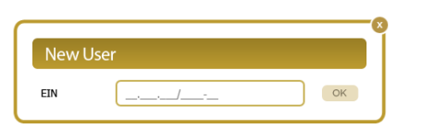
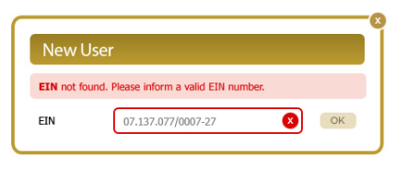
Frontend
Step1-Pop-Document.psd / Step1-Pop-Document-NotValid.psd
This message shows if the typed number does not exists in the database
Required field validation.
Shows the border in case the user submit the form without typing the number

Slide 7
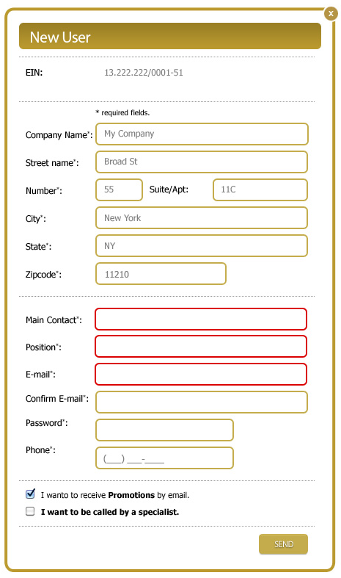
Frontend
Step2-Pop-Document-Register.psd
Number typed by the user on step 1
In case the email already exists on the DB, needs to show a message like this one:
Required field validation.
Shows the border in case the user submit the form without typing the number

Slide 8
Backend
You are allowed to use any structure that you desire
I.e. BLL & DAL layers or MVC or anything that you use to work
Database MUST be SQL Server 2008 (Express version or any other version)
Database queries (C# -> DB) needs to be done by using Stored Procedures (insert and selects)
You will need to provide the database scripts with the final deliver
The application needs to be created using Visual Studio 2010

Slide 9
Deliver
Zip or rar file containing all ASPX and C# files – Visual Studio Solution
All required database scripts
It includes create table, create procedure, any data poluation, such as inserts
In case needs, any specific configuration or folder permission
Any additional DLL or external library used in the project

